Slide 1
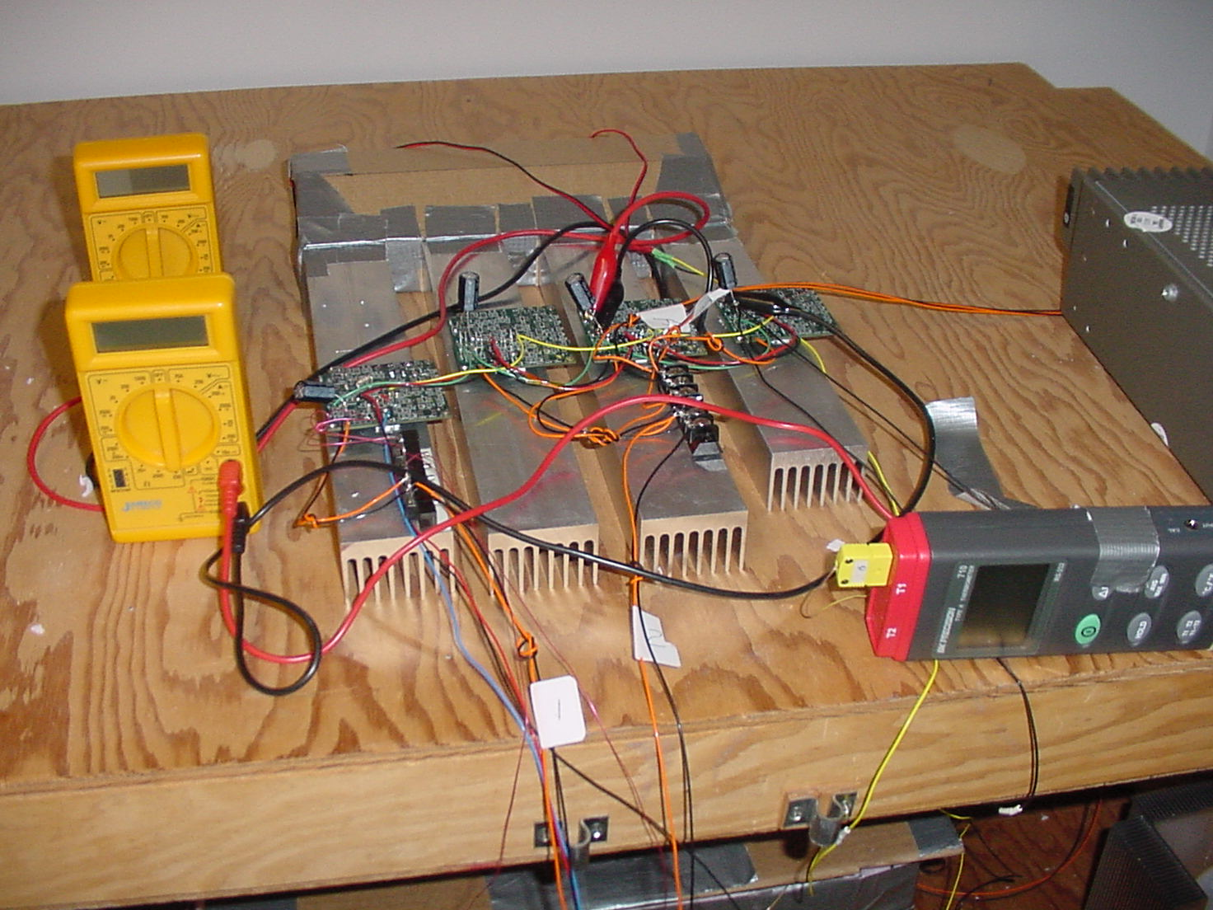
PAX TEC Control, Driver Electronics and Driver Electronics Heat Sink - Breadboard
PAX TEC Control and Driver (and heat sink for driver)
1 of 4; 1 is required for for each the 4 TECs that cool each PAX
Under worst case TEC driver needs to dissipate same power as
TEC

Slide 2
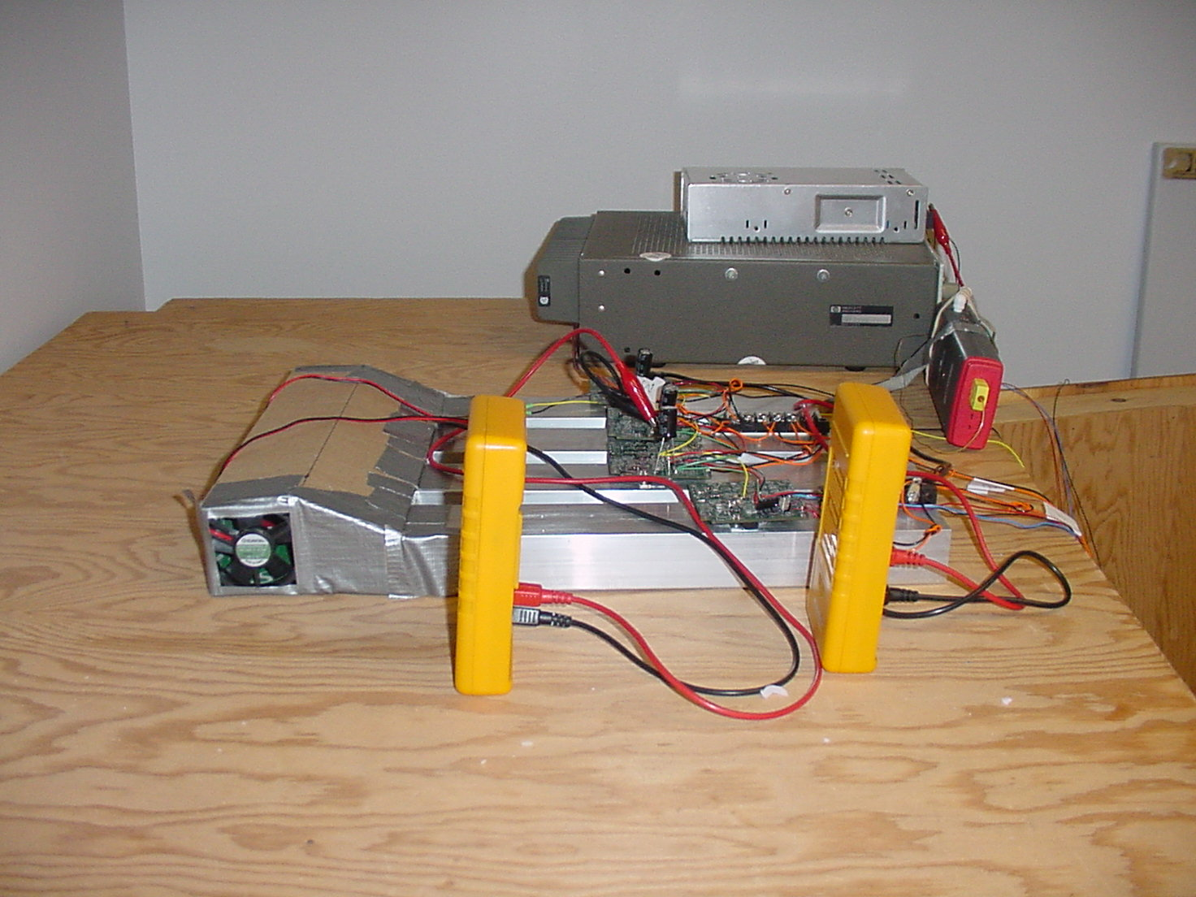
PAX TEC Driver Electronics – Breadboard; side view
Temporary forced air cooling fan and plenum adaptor
for PAXTEC driver heat sink

Slide 3
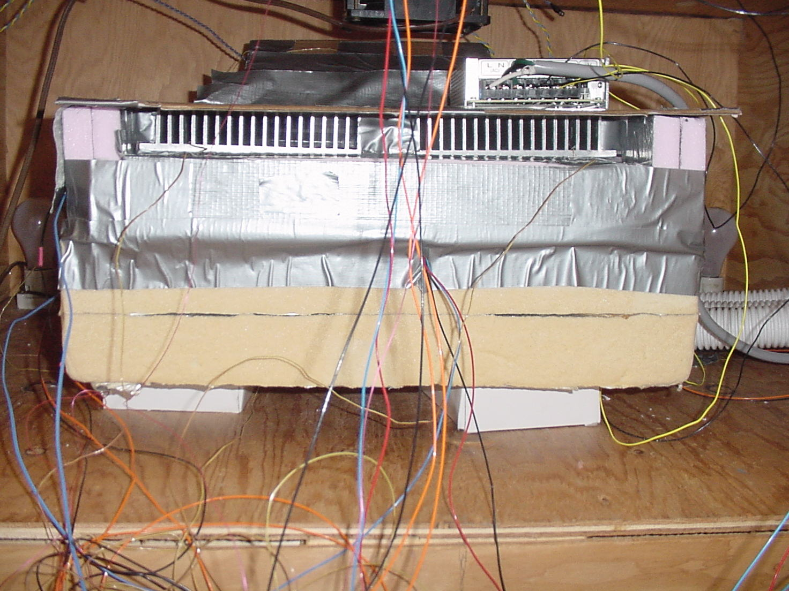
PAX with TECs and TEC Heat Sinks
Front View
PAX TEC heat sinks;
TECs are mounted between
top of PAX and bottom of heat sink
PAX with insulation

Slide 4
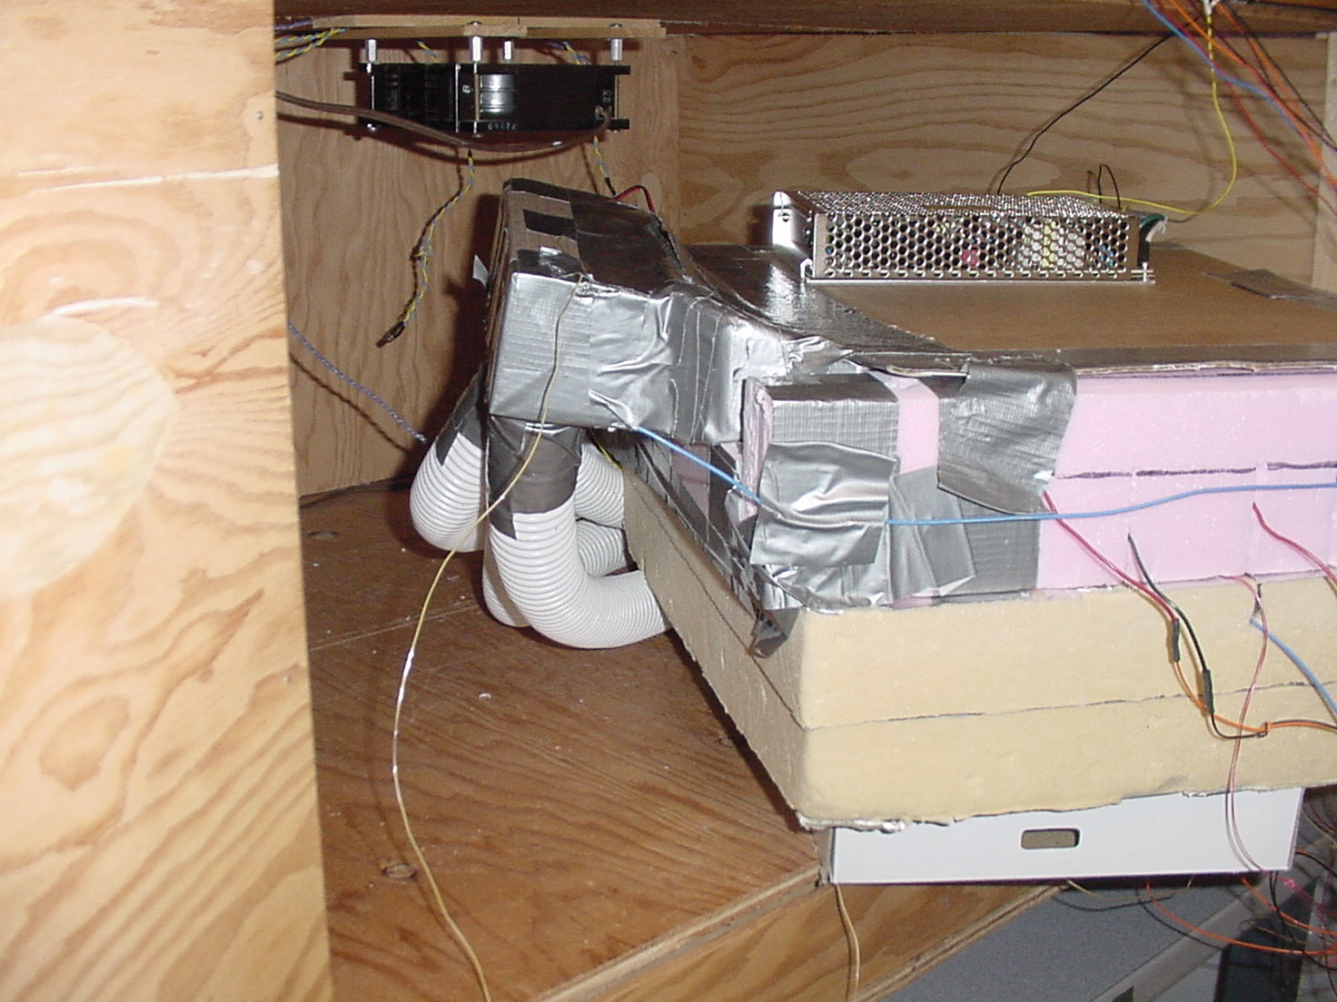
PAX with TECs and TEC Heat Sinks
Rear View
Temporary plenum
adaptor for PAX
TEC heat sinks.
Provides transition
between cooling air
ducts and rectangular
air duct over PAC TEC
heat sinks
Cooling air ducts
PAX with insulation

